Slide 1


Subject to policy
Using Artificial Intelligence to develop a policy thesaurus
Dr Yong-Bin Kang - Research Fellow
Les Kneebone - Information Architect
APO.ORG.AU

Slide 2
Overview
Tidying up a folksonomy - Les Kneebone
Data Analytics on APO documents and subject terms - Dr Yong-Bin Kang
Applications for a shared taxonomy - Les Kneebone
#subjectToPolicy
@APOorgau

Slide 3

APO.ORG.AU

Slide 4
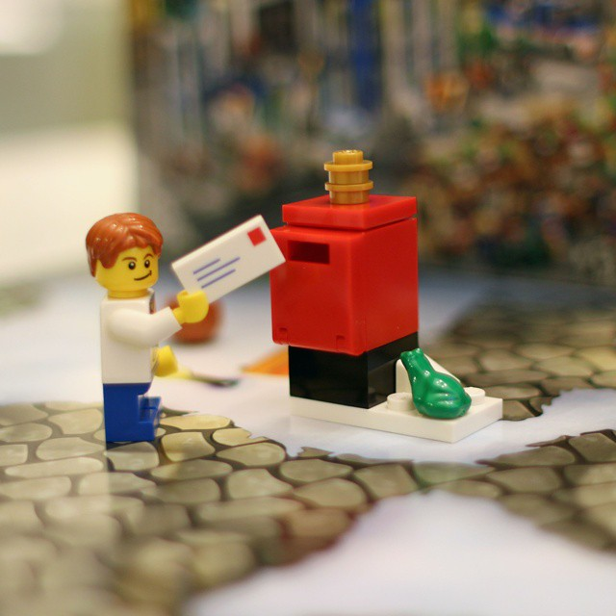
bnilsen
(CC BY-SA 2.0)

Slide 5
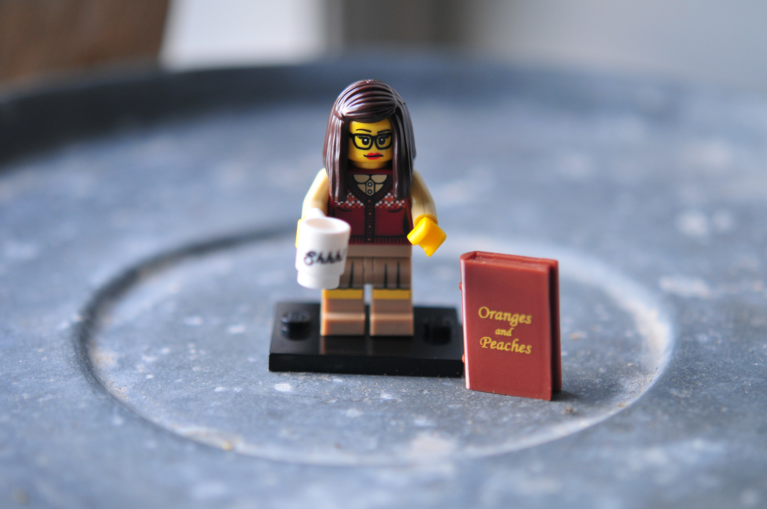
Julochka
(CC BY 2.0)

Slide 6

> 5,000 tags

Slide 7

Language sources
Literature
Cataloguing / indexing
Search analytics

Slide 8
Guy and Tonkin (2006) Folksonomies: Tidying up Tags?
Synonym control – Domestic violence vs Family violence
Hierarchy control – Adolescent family violence vs FV
Associations – FV vs Emergency housing

Slide 9


Australian Government Interactive Functions Thesaurus (AGIFT)
Australian and New Zealand Standard Research Classification - Fields of Research (FOR)

Slide 10
Part 2: Data Analytics on APO documents and subject terms

Slide 11
67986 Built environment
21819 Communication
20612 Culture
21120 Economics
20387 Education
56421 Environment
57741 Healthcare
58171 Indigenous
20158 International relations
20687 Justice
20296 National security
20408 Politics and government
20764 Science
62731 Social issues
21582 Technology
Technology
NT: Information technology
Engineering
Transport

Slide 12
Applications for a shared taxonomy

Slide 13
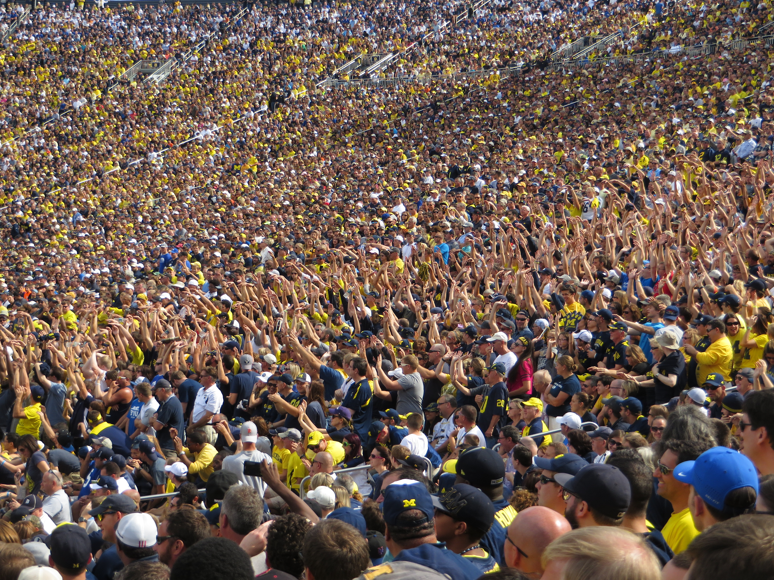
Ken Lund (CC BY-SA 2.0)

Slide 14
Linking fields of research and functions of government

Slide 15
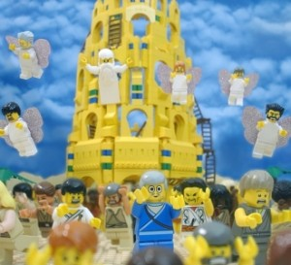
Caplan (1979) Two-Communities Theory
“… knowledge produces and knowledge users… live in separate worlds with different and often conflicting values, different rewards systems, and different languages”
“Tower of Babel” – permission by Elbe Spurling

Slide 16
Domestic violence

Slide 17
Family violence
Used For: Domestic violence

Slide 18
20194
Family violence
Used For: Domestic violence

Slide 19
20194
Family violence
Used For: Domestic violence
Narrower: Adolescent family violence
Related: Emergency housing

Slide 20
http://vocab.apo.org.au/20194
Family violence
Used For: Domestic violence
Narrower: Adolescent family violence
Related: Emergency housing

Slide 21
http://purl.org/au-research/vocabulary/anzsrc-for/2008/1603
Family and household studies
http://vocab.apo.org.au/20194
Family violence
https://data.naa.gov.au/def/agift/Counselling-services.htm
Counselling services

Slide 22
http://purl.org/au-research/vocabulary/anzsrc-for/2008/1603
Family and household studies
<skos:closeMatch>
http://vocab.apo.org.au/20194
Family violence
<skos:closeMatch>
https://data.naa.gov.au/def/agift/Counselling-services.htm
Counselling services

Slide 23
Applications?
Search and navigation in retrieval systems
Automated classification and cataloguing
Harmonize meanings between publication repositories
Recommendation systems
Improve text mining applications

Slide 24

AI

Slide 25

Dictionary
Piecemeal addition of ‘stop words’

Slide 26

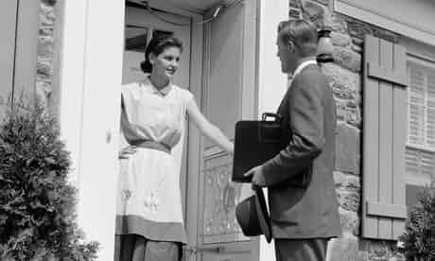
Encyclopaedic
expand training corpus with general knowledge sources

Slide 27
Take a thesaurus developed with inputs from communities of practice, as the foundation for defining
artificial intelligence rules
Community Informed Artificial Intelligence

Slide 28
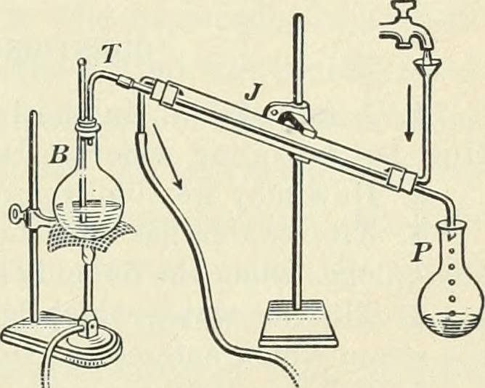

Slide 29
https://github.com/leskneebone/policyThesaurus

Slide 30

Find APO
#subjectToPolicy
https://github.com/leskneebone/policyThesaurus

Slide 31
Heading 1
Heading 2
Heading 3
Heading 4
Level 5
Main body text
Links: apo.org.au/subscribe
#Hashtags

Slide 32




APO logos
APO.ORG.AU

Slide 33




APO partner logos
Open Access symbol

Slide 34
APO brand assets
APO Brand Style Guide: drive.google.com/open?id=1iOJkE5xYTnyjL8szNCXMCufXMX-QXGIc
Icons: drive.google.com/drive/folders/1ap4utJmU4vv1-317YvcnKrI0wLxK6JZS
Buttons: drive.google.com/drive/folders/1PirPwcZ0XbpB8yzo8NClVQnWc6gbOvNU
APO brand video (1.22 min): youtu.be/-Rr2CS8aa_k
APO brand video (0.31 min): youtu.be/AsNh6nJIUvg

Slide 35
Colour & font guide
COLOUR | HEX CODE | SUGGESTED USE | STYLE
Spring Wood | #EFEBE2 | Main slides background
Pearl | #EOD8C6 | Cover title | Calibri, 36, Bold, UPPER CASE
White | #FFFF | Cover presenter title & role | Calibri, 18, Bold, Title Case
Logo Cab Sav | #690A1B | Heading 1 | Calibri, 36, Bold, Sentence case
Venice Blue | #076D8B | Heading 2, Cover slide background, links | Calibri, 30, Bold, Sentence case
Pumpkin | #F68212 | Heading 3, Cover slide subtitle | Calibri, 24, Bold, Sentence case
Torch Red | #F40224 | Heading 4, hashtags | Calibri, 18, Bold, Sentence case
Burgundy | #8C0019 | Heading 5, slide numbers | Calibri, 18, Bold, Italic, Sentence case
Mine Shaft | #464646 | Main body text | Calibri, 18
Black | #000000 | Miscellaneous

